Slide 1
Decode & Detect
PRE-HACKATHON TRAINING · 23 OCTOBER 2026
Money laundering, transaction fraud and how to spot them on a public ledger
Muhamed Retkoceri
Hackathon: 24 October · IDEALondon

Slide 2
From “what is laundering?” to a valid submission
THIS PART OF THE SESSION
01
02
03
Fraud vs laundering
What AML teams do
Patterns on a public ledger
04
05
06
The challenge data
Scoring, rules, submission
How to approach the day
Decode & Detect · AML training
2

Slide 3
Two different crimes, often linked
01 · FRAUD VS LAUNDERING
Transaction fraud
Money laundering
Someone is tricked or robbed. There is a victim and a loss.
Criminal money is moved until it looks clean. The goal is to hide where it came from.
Scam and phishing payments
Account takeover
Card and payment fraud
Proceeds of fraud, drugs, corruption
Passed through many accounts
Converted between assets
“Should this payment happen at all?”
“Where did this money really come from?”
Stolen money from fraud usually needs laundering next. This hackathon is about laundering.
Decode & Detect · AML training
3

Slide 4
Anti-money laundering is a pipeline
02 · WHAT AML TEAMS DO
Know the customer
Monitor payments
Investigate alerts
Report
Keep records
UK: a Suspicious Activity Report to the NCA’s Financial Intelligence Unit.
So regulators can check the work.
Identity checks when an account opens.
Flag flows that look wrong.
An analyst reviews each one by hand.
Your job tomorrow
Analysts can only review so many alerts a day. A good model puts the real cases at the top of their queue. That is exactly what tomorrow’s score measures.
UK law: Proceeds of Crime Act 2002 · Money Laundering Regulations 2017
4

Slide 5
The three stages of laundering
02 · WHAT AML TEAMS DO
1 · Placement
2 · Layering
3 · Integration
Dirty money gets in
Moved to break the trail
Comes back looking clean
Bank: cash split into small deposits.
Bank: wires across accounts and countries.
Bank: property, fake business income.
Ledger: crypto bought through an exchange or a mule’s wallet.
Ledger: cashed out through an exchange, or spent.
Ledger: quick hops, splits, merges and currency conversions.
The challenge data is mostly about layering: money moving between wallets.
Decode & Detect · AML training
5

Slide 6
On a public ledger every payment is visible. Who is behind each wallet is not.
03 · PATTERNS ON A PUBLIC LEDGER
So you judge by behaviour: timing, amounts, and who connects to whom.
Decode & Detect · AML training
6

Slide 7


What the data shows, and what it hides
03 · PATTERNS ON A PUBLIC LEDGER
You can see
You cannot see
Sender and receiver wallet
Amount and which asset
Exact time of each payment
Conversions between assets
Every wallet’s history in the window
Names or identity checks
Why a payment was made
Bank accounts or cash
Anything outside the 7-day window
Decode & Detect · AML training
7

Slide 8
The XRP Ledger in six terms
03 · PATTERNS ON A PUBLIC LEDGER
1 · A wallet is an address
2 · XRP comes in drops
A string starting with r and no name. You judge behaviour, not identity.
1 XRP = 1,000,000 drops. For XRP rows, SOURCE_VALUE is in drops.
3 · A token is issuer + code
4 · A conversion is one transaction
USD, GBP and EUR here are IOUs from an issuer. USD from issuer A and USD from issuer B are two different assets.
The sender pays one asset and the receiver gets another, via one or two liquidity providers: 2 or 3 transfer rows.
5 · Fees are burned
6 · SendMax is a ceiling
Every transaction destroys 10 to 15 drops of XRP, even token payments.
DELIVERED_AMOUNT is what arrived; the first leg, what was really paid.
All of this holds on the real ledger; the challenge data keeps the same rules.
7b

Slide 9
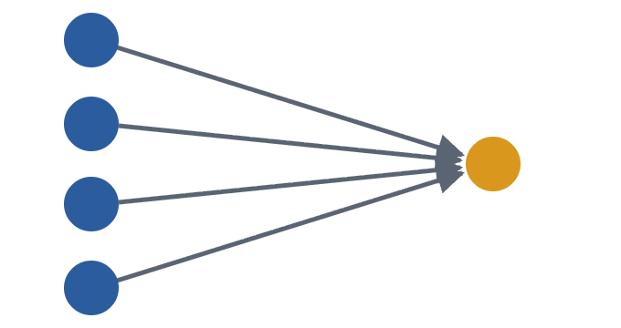
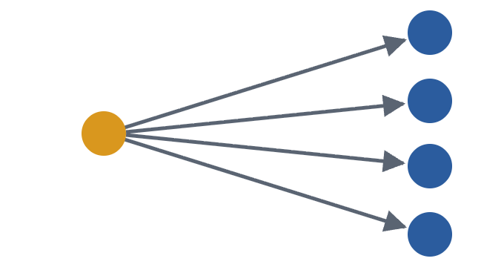
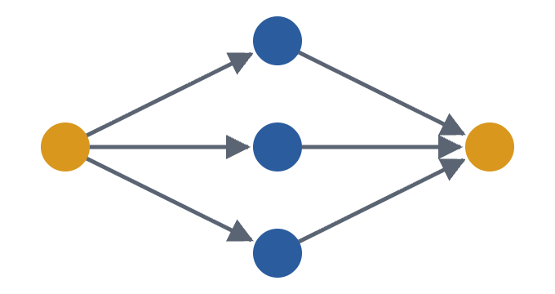
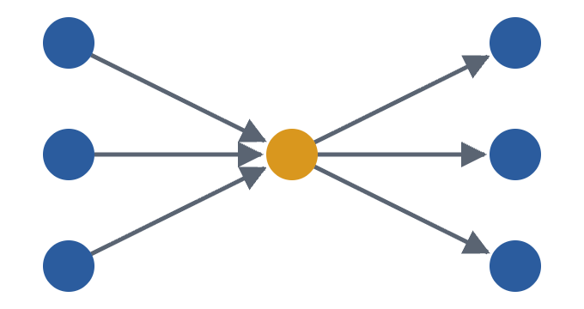
Laundering shapes, part 1: collect and spread
03 · PATTERNS ON A PUBLIC LEDGER
Fan-in
Fan-out
Scatter-gather
Gather-scatter
Many wallets pay into one. Often mules feeding a collector.
One wallet pays many. Breaks a large sum into pieces.
Split across middlemen, then merged again downstream.
Collect from many, then pay out to many.
Orange = the wallet to watch. Every one of these shapes also happens in normal business.
Pattern families from IBM's AMLworld synthetic AML datasets (Altman et al., NeurIPS 2023)
8

Slide 10
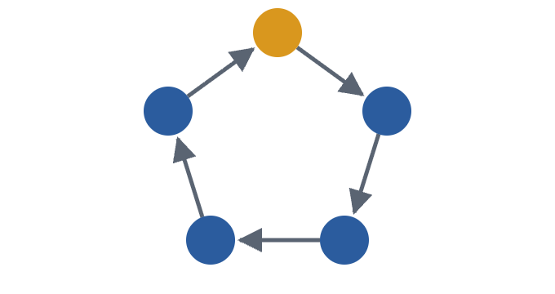
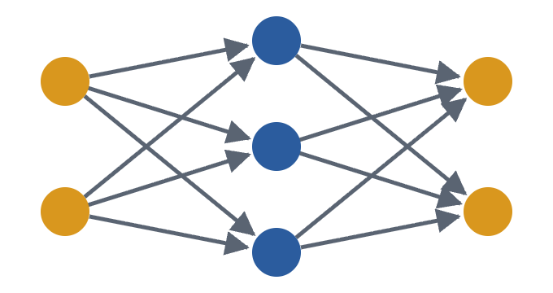
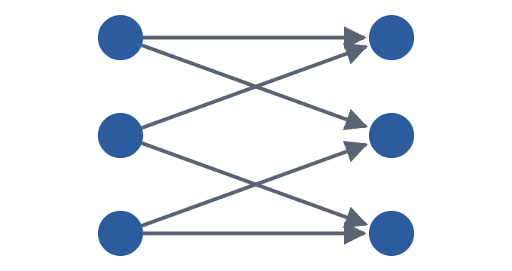
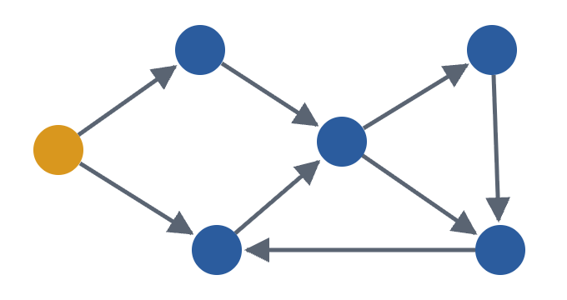
Laundering shapes, part 2: loops and layers
03 · PATTERNS ON A PUBLIC LEDGER
Cycle
Layered stack
Bipartite
Irregular network
Money goes round and returns to where it started.
Layers of wallets between source and destination.
One group of wallets pays another, many to many.
Branching routes with merges and returns.
Real cases mix these shapes, spread over hours or days, and across assets.
Pattern families from IBM's AMLworld synthetic AML datasets (Altman et al., NeurIPS 2023)
9

Slide 11
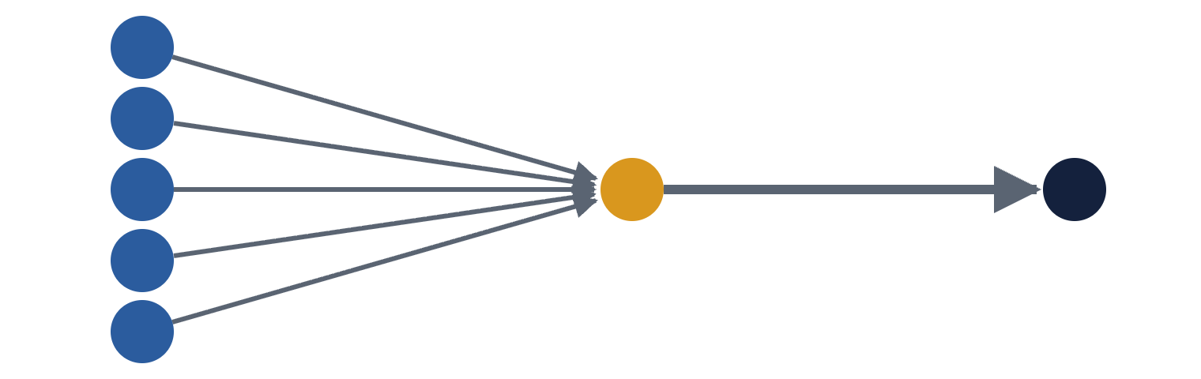
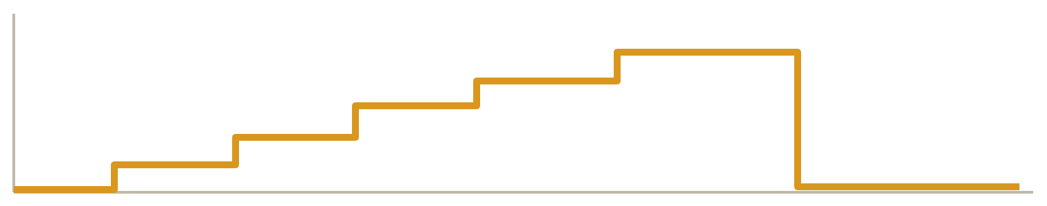
Fan-in: many wallets feed one
SHAPE 1 OF 8 · FAN-IN
How it works
Many wallets, often money mules, each send a modest amount to one collector. The collector then moves the total on in one or a few large payments.
Legitimate look-alike
A shop taking customer payments, a fundraiser, or an exchange deposit address.
Sources (mules)
Collector
Exit
Signals to compute
Distinct senders into one wallet in a short window
Senders that are new or do nothing else
Time from the last deposit to the exit payment
Exit amount close to the sum of the deposits
Collector balance: fills in steps, empties at once
Decode & Detect · AML training
10

Slide 12
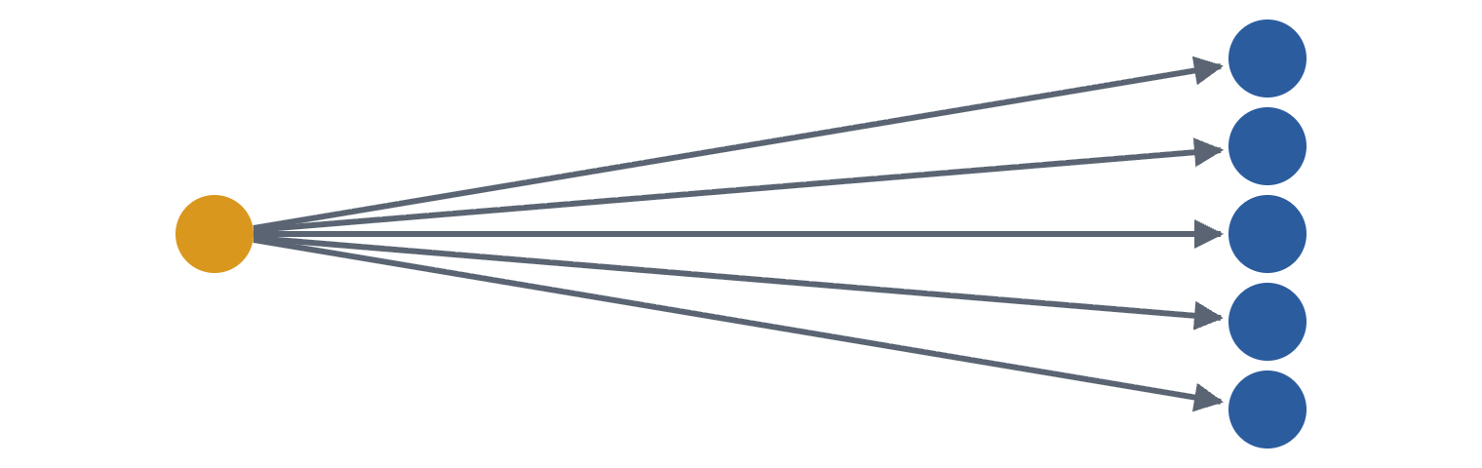
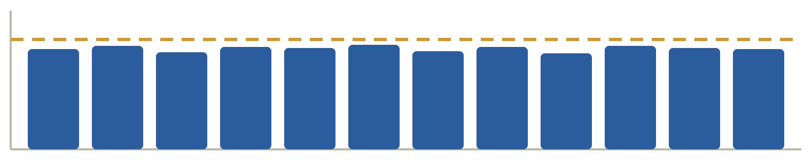
Fan-out: one wallet pays many
SHAPE 2 OF 8 · FAN-OUT
How it works
One wallet splits a large balance into many smaller payments. The recipients often pass the money on again, which starts the next layer.
Legitimate look-alike
Payroll, refunds, giveaways, or an exchange sending out withdrawals.
Source
Recipients
Signals to compute
Distinct recipients per sender in a short window
How similar the payout amounts are
Recipients that forward the money quickly
A source that was funded just before
Payout sizes: very similar (illustration; dashed line is a US limit)
Decode & Detect · AML training
11

Slide 13
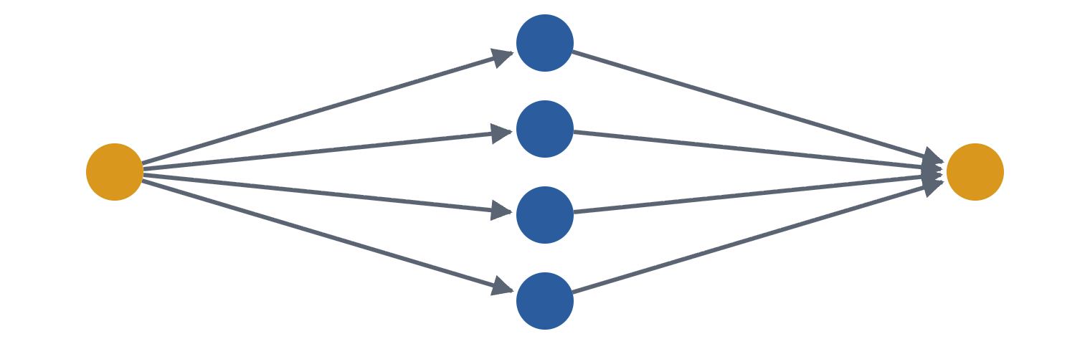
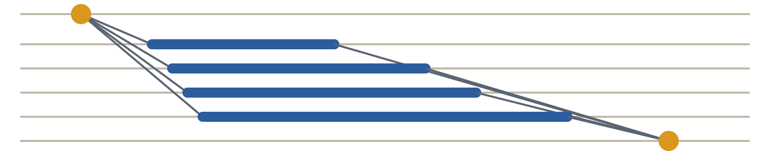
Scatter-gather: split, then merge again
SHAPE 3 OF 8 · SCATTER-GATHER
How it works
Money leaves one wallet through several middlemen and meets again at one destination. Each path on its own looks small and ordinary.
Legitimate look-alike
A company moving money between its own accounts, or an exchange rebalancing.
Source
Middlemen
Destination
Signals to compute
Several two-hop paths between the same pair of wallets
Value out of the source close to value into the destination
Middle wallets with no other activity
Hold times that are short and similar
Timeline: one split, four holds (bars), one merge
Decode & Detect · AML training
12

Slide 14
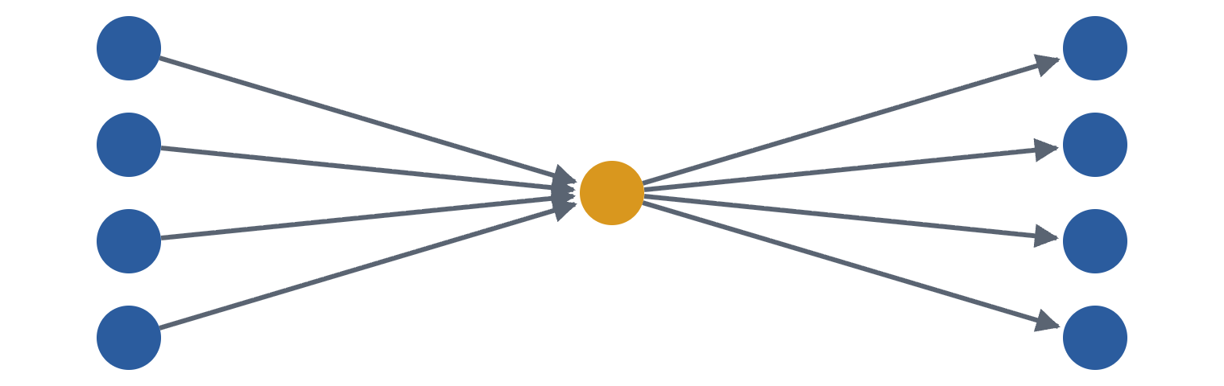
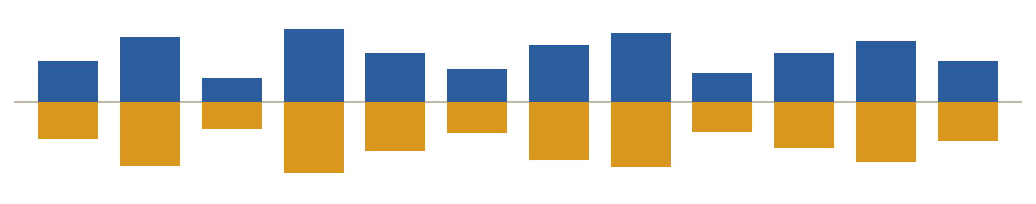
Gather-scatter: a hub in the middle
SHAPE 4 OF 8 · GATHER-SCATTER
How it works
A hub collects from many wallets and pays out to many others. Like a mixing point, it breaks the link between any one sender and any one receiver.
Legitimate look-alike
An exchange hot wallet, a payment processor, or a payroll provider.
Many in
Hub
Many out
Signals to compute
Many senders and many receivers on one wallet
Little balance kept compared with what flows through
Short time between money in and money out
Senders and receivers that never overlap
Hourly flows: in (blue, up) mirrors out (orange)
Decode & Detect · AML training
13

Slide 15
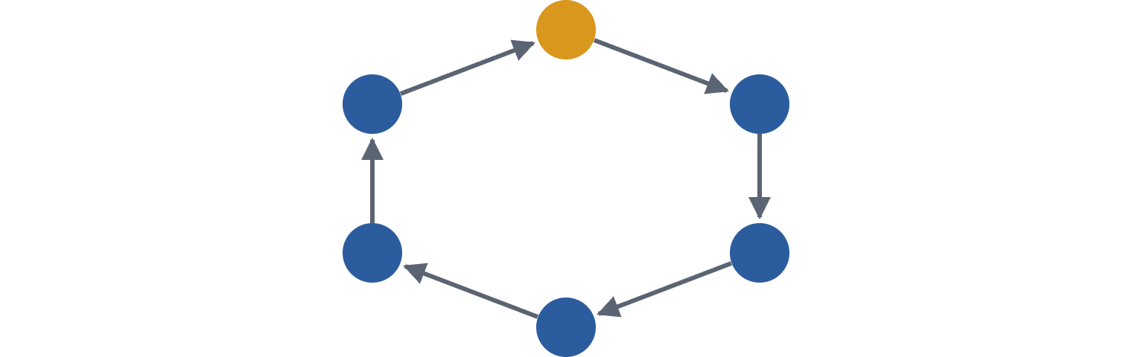
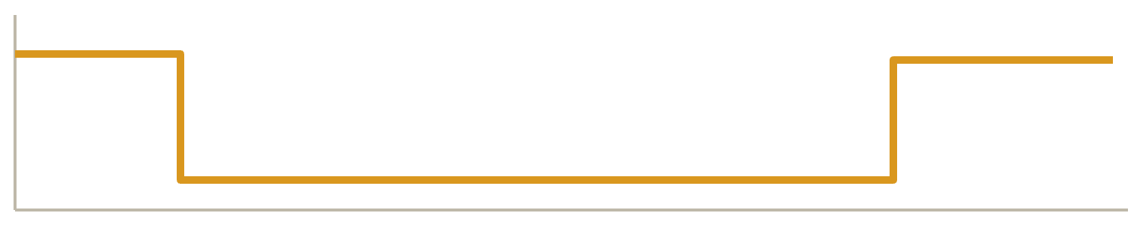
Cycle: money goes round and comes home
SHAPE 5 OF 8 · CYCLE
How it works
Funds leave a wallet, pass through several others and come back. It can fake trading volume, or wash money through a currency round trip.
Legitimate look-alike
Arbitrage and market making, refunds, or moves between a firm’s own wallets.
Origin at the top; the loop brings the money back
Signals to compute
A path that returns to its start within a time window
How many hops the loop has, and how long it took
Value returned compared with value sent
Assets that change along the way
Origin balance: leaves, travels, comes back
Decode & Detect · AML training
14

Slide 16
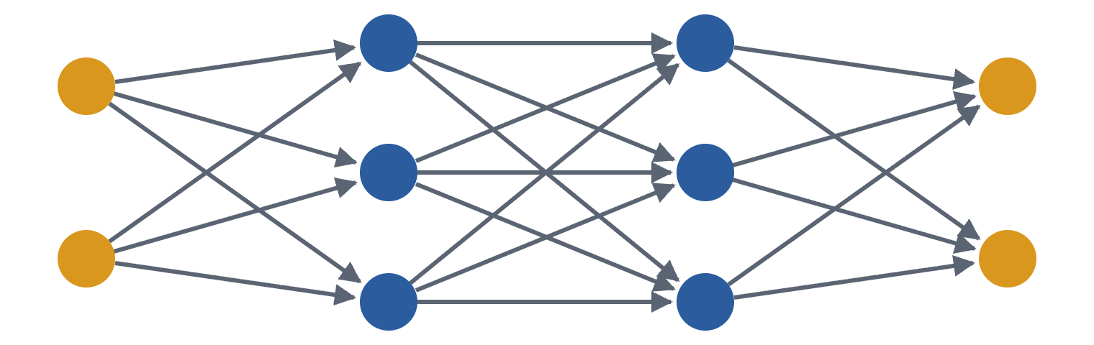
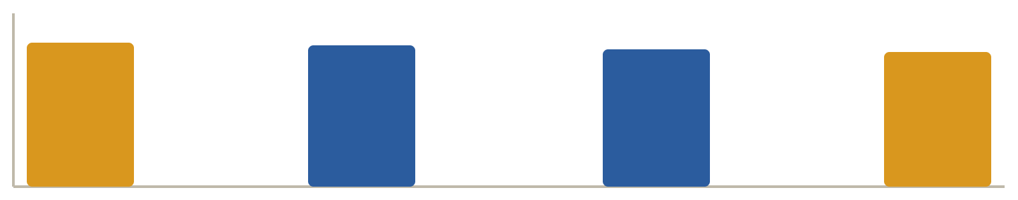
Layered stack: rows of middlemen
SHAPE 6 OF 8 · LAYERED STACK
How it works
Money passes through several rows of intermediary wallets. Every layer adds distance between where it came from and where it ends up.
Legitimate look-alike
Payment processors and correspondent chains, or a group of companies paying each other.
Sources
Layer 1
Layer 2
Destinations
Signals to compute
Depth: the longest chain a payment can be followed along
Middle wallets used once, then abandoned
Value kept almost whole from layer to layer
Similar delays at each layer
Value at each layer: almost all of it gets through (illustration)
Decode & Detect · AML training
15

Slide 17
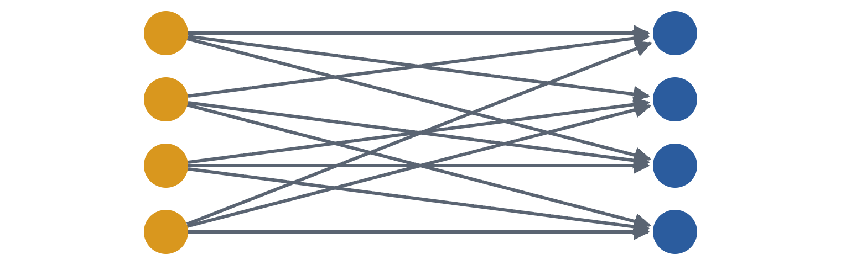

Bipartite: one group pays another
SHAPE 7 OF 8 · BIPARTITE
How it works
A set of wallets pays another set, many to many. Spreading across both sides keeps every single pair small and easy to miss.
Legitimate look-alike
Marketplace buyers and sellers, or a company paying its suppliers.
Group A (payers)
Group B (receivers)
Signals to compute
Dense blocks of payments between two sets of wallets
Groups with few contacts outside the block
Many pairs active in the same time window
Similar amounts across the pairs
Rows: group A. Columns: group B, then all others
Decode & Detect · AML training
16

Slide 18
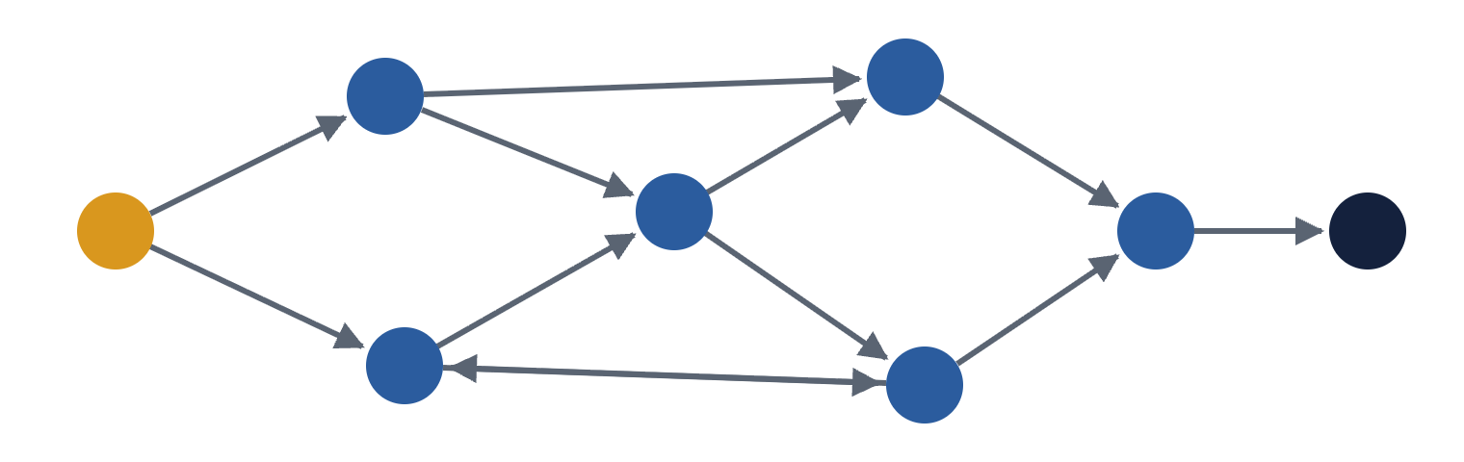
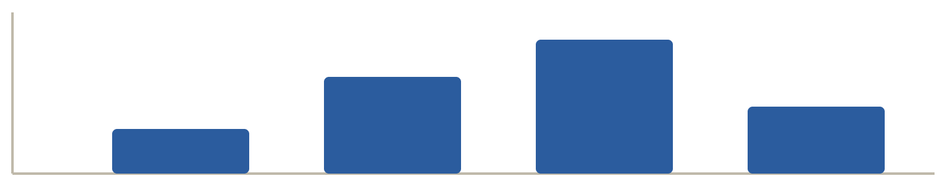
Irregular network: no clean template
SHAPE 8 OF 8 · IRREGULAR NETWORK
How it works
Money takes many partial routes, with splits, merges and returns. It is the hardest shape to catch with fixed rules.
Legitimate look-alike
Ordinary peer-to-peer life: friends, families and local traders paying each other.
Entry
Splits, merges, a return
Exit
Signals to compute
Size and density of the connected group
Number of distinct routes between two wallets
Value into the group versus value out of it
How tightly the activity is packed in time
Routes entry to exit by length: 3, 4, 5, 6 hops
Decode & Detect · AML training
17

Slide 19
Behaviour that raises a flag
03 · PATTERNS ON A PUBLIC LEDGER
Rapid pass-through
Hops with no purpose
Splitting
Money leaves soon after it arrives, and little is kept.
Long chains through wallets that do nothing else.
One amount broken into many smaller payments.
Currency hopping
Round-tripping
Patterns over time
Converting through several assets to blur the trail.
Funds come back to where they started, maybe in another asset.
A flow that only makes sense when you look at the whole week.
Decode & Detect · AML training
18

Slide 20
A pattern is not proof: two real examples
03 · PATTERNS ON A PUBLIC LEDGER
Fast forwarding
A tiny loop
Wallet A sends 50 XRP to B. Nineteen seconds later B sends 49.999985 XRP to C. The difference, 15 drops, is the fee B paid; the minimum is 10.
40 payments of 0.00001 XRP each, going round ten accounts in a cycle.
Looks like: a laundering cycle.
Could be: a bot or a test. The total is worth almost nothing.
Looks like: layering.
Could be: an automated service passing funds on.
Exchanges, payroll, merchants and treasury moves make the same shapes. Context separates them.
Real public XRP Ledger payments, 12 October 2026 (AWS public blockchain data). Purpose not established.
19

Slide 21
A fictional ledger in the real XRPL format
04 · THE CHALLENGE DATA
40,131
40,101
7 days
training transactions, with labels
test transactions to score
of activity per split
File | What is in it
transactions.parquet | One row per transaction: sender, fee, payment details as JSON
transfers.parquet | The money legs: 1 to 3 rows per transaction
blocks.parquet | Ledger records: index, hash, close time
market_rates.csv | Hourly reference USD price for each asset
labels.csv | Training split only: which transactions are suspicious
Synthetic data in the AWS/SonarX XRP Ledger schema. Not real accounts or real crime.
20

Slide 22
Six traps to avoid in the first hour
04 · THE CHALLENGE DATA
1 · Score transactions, not transfers
2 · XRP comes in drops
Join on TRANSACTION_HASH. One row per transaction in your CSV.
For XRP rows, SOURCE_VALUE is in drops: 1 XRP = 1,000,000 drops.
3 · An asset is address + symbol
4 · SendMax is a ceiling
Group by TOKEN_ADDRESS and SYMBOL. USD from two issuers is two assets.
It is not the cost. The first transfer leg shows what was really paid.
5 · Compare value in USD
6 · Some fields are JSON text
Use market_rates.csv, the hour that contains the payment.
Parse EXTRA_TRANSACTION_FIELDS and DELIVERED_AMOUNT.
Full details: README.md in the data package
21

Slide 23
What is hiding in it
04 · THE CHALLENGE DATA
Suspicious transactions, by difficulty
Easy · 64%
Medium · 18%
Hard · 18%
Lots of normal life
Hard means history
Test is not train
Shopping, peer payments, exchange and payroll hubs, legitimate treasury flows. Both sides use conversions.
Hard cases span many payments and changing counterparties. Look at whole flows, not single amounts.
The test data has variations absent from training. A few cases are deliberately ambiguous.
Source: README.md in the data package. A suspicious label describes the scenario’s intent, not a rule for real life.
22

Slide 24
Score = 100 × Average Precision
05 · SCORING, RULES, SUBMISSION
A worked example: five transactions, two suspicious
Only the order counts
Rank | Your score | Truth | Precision so far
1 | 0.97 | Suspicious | 1 of 1 = 1.00
2 | 0.91 | Legit | −
3 | 0.88 | Suspicious | 2 of 3 = 0.67
4 | 0.40 | Legit | −
5 | 0.12 | Legit | −
Put the suspicious ones at the top. Scores need not be probabilities.
Avoid ties
Equal scores are grouped as one block. Use continuous scores, not just 0 and 1.
AP = (1.00 + 0.67) ÷ 2 = 0.83 → score 83
Also shown: top 1%
Precision and recall in your top 402 transactions, plus ROC-AUC. Not part of the ranking.
Scored against private organiser labels on all 40,101 test transactions
23

Slide 25
The rules
05 · SCORING, RULES, SUBMISSION
Organiser data only
Any tools
AI allowed, disclosed
No outside transaction or reference data without approval. Public docs and papers are fine.
Any language or model: rules, statistics, trees, neural nets, graph methods.
LLMs and coding assistants are fine. Name the model and provider; include prompts and settings.
Built on the day
Reproducible
Open source
Libraries and pre-trained models are fine. The work being judged is done during the hackathon.
Exact run command, seeds, dependencies. If we cannot reproduce it, we may retract it.
Release under an approved licence by the deadline. Every member accepts the terms.
Full terms: hackathon.ukcbt.org/terms
24

Slide 26
Submit by 16:30 London, 24 October
05 · SCORING, RULES, SUBMISSION
Upload two files at hackathon.ukcbt.org with your organiser access code.
Predictions CSV
Code ZIP
TRANSACTION_HASH,score
Code, exact run command, seeds, dependencies
Team list, commit or version, results
Method: under 10 slides or 4 pages
At most 8 MiB; no secrets, no installed packages
All 40,101 test transactions, once each
Scores between 0 and 1
At most 12 MiB
50 uploads per team per UTC day. The leaderboard shows your best completed run and stays provisional until we verify it.
Pitch length: to be confirmed on the day
25

Slide 27
A plan that works
06 · HOW TO APPROACH THE DAY
1
2
3
Load and join
One edge per payment
Run the baseline
Transactions, transfers, rates. Check the row counts.
Who paid whom, how much in USD, when. The supplied payments.py does this.
baseline.py gives you a valid file and a number to beat.
4
5
6
Study the labels
Build features
Validate, then submit
Look at suspicious flows in training. What makes them differ?
Timing, amounts, graph shape, each wallet’s history.
Hold out part of training and measure AP yourself first.
Keep notes as you go. Judges want to know why your model works, not only its score.
Decode & Detect · AML training
26

Slide 28
Questions?
DECODE & DETECT
This is synthetic data. A high score here does not prove a method works on real financial crime.
See you at IDEALondon, 24 October
Deadline 16:30 London

